Slide 1
Go Language

Slide 2
What is Go?
Go Language is safe as it is strongly and statically typed and supports garbage collection.
It's statically typed because you can't change a variable's type at runtime
Strong typing: Go is a statically typed language, which helps catch errors at compile time rather than at runtime.
Go's garbage collection is a mechanism for automatically releasing memory that is no longer needed by a program. The Go runtime uses a garbage collector to periodically scan the program's heap (the area of memory where objects are allocated), looking for objects that are no longer reachable.
It supports concurrent programming, functional programming, and interfaces.
Go provides unit testing features.
Platform independent.

Slide 3
Writing first program in Go:
Line 1: It contains the package main of the program, which have overall content of the program. It is the initial point to run the program, So it is compulsory to write.
Line 2: It contains import “fmt”, it is a preprocessor command which tells the compiler to include the files lying in the package.
Line 3: main function, it is beginning of execution of program.
Line 4: fmt.Println() is a standard library function to print something as a output on screen / in console. In this, fmt package has transmitted Println method which is used to display the output.
Also notice that We are using capital P because we have exported that method from that package. Also, similarly we want export any variable or functions that mentioned name should starts with capital latter so easily.

Slide 4
Variables, Strings & Numbers
Variables are used to store information temporarily to be referenced and manipulated in a computer program.
In Go, a variable stores a value of the specific data type. It can store a numeric, Boolean, string, or other types of value.
Variable Declaration and Initialization
There are two ways to declare a variable in Go lang:
Using var keyword
The most common method of describing a variable in Go lang is by using the keyword var.
Using the shorthand syntax
Use := to declare and assign a value to a variable without using the var keyword with implicit type.
Built In Pkg

Slide 5
Printing & Formatting Strings
Package “fmt” used to format strings and print them out to the console.
Few diff methods that we can use to do this
Print
Println
Sprintf
Printf
There are many format specifiers we have just seen a few of them and if we want to check more that link is going to be down below which shows all of the different formatter's specifiers right here so you can check.
Formatters

Slide 6
Arrays & Slices
In Go, an array is used to store multiple values of the same data type in a single variable. It can also be described as a numbered sequence of elements of a specific length.
An array's length is part of its type, so arrays are of fixed size and cannot be resized.
Arrays can be declared in two ways:
Using var keyword
Using the shorthand declaration :=
Var array_name[length]Type
array_name:= [length]Type{item1, item2, item3,...itemN}

Slide 7
Slices
Slice is a lightweight and flexible data structure in Go. Slices store multiple elements of the same type in a single variable same as arrays. But unlike arrays, a slice's length can grow and shrink as needed.
A slice is declared like an array but without specifying the size as it can grow or shrink as per the requirement.
sliceName := []datatype { value1, value2, value3,...valueN }
Unlike arrays, the length and the capacity of a slice can be different. Length is the number of elements in the slice and capacity is the number of elements a slice can contain. The len() returns the length and the cap() returns the capacity of a slice.

Slide 8
The Standard Library
Go lang providers many stander packages, which easy to use and manupalte data.
Go comes with a very lightweight set of functions and features right out of the box it doesn’t come with many methods for strings, integers or arrays or anything like that we can use as it is however it does provide us with a standard library of packages that we can use an each brings with it its own set of functions or values we can use in our files
We have already seen one tha “fmt” package where we can use thigs like printf or sprint etc but there also other packages for stings which includes method for manipulating strings for slices which include methods to sort collections etc. you just have to import functionality that you need and all of the different standard library packages are right here on the go website.
Packages link:
String pkg

Slide 9
Loops
In Go, the for loop is used to execute a block of code a specific number of times until a specified condition is met. The for loop is the only loop available in Go lang
A loop is a sequence of instructions that is repeated until a certain condition is reached. In programming, we use loops to repeat a block of code until a specific condition is met.
Example:-

Slide 10
Booleans & Conditionals
We already seen that an expressions can be true or false using a for loop in the last slide and true or false value is a Boolean in go. Just like a Boolean in other programming languages and I have just created a few other expressions that also result in Boolean either true or false
Example :-

Slide 11
Functions in Go
In Go, the function is a set of statements that performs a specific task and can be reused repeatedly in a program. Functions improve the readability and maintainability of a program.
A function can take input parameters and can also return an output. Input parameters and output are optional to a function.
Every Go program will have at least one function main() function which is the starting point.
func functionName ([inputParameters]) [returnType] {
//function body
}
Examples:-

Slide 12
Multiple Return Values
In last slide we saw how t create functions that return multiple values so not just one value
Now we want to return two diff values so this is going to be a slightly more complex function that we are going to create to put together some ot the thing we have learned so far as well as use the stings package right here .
Example:-

Slide 13
Package Scope
All right then so sometimes when we are making go programs we probably want to make more than one file right you don’t want to do everything inside in this one single main.go file and we can do that so
Example:-

Slide 14
Maps in Go
In Go lang, a map is a data structure that stores key-value pairs where keys must be unique but values can be duplicate.
Maps can be declared using var or shorthand syntax.
// Using var keyword
var mymap = map[TypeOfKey] TypeOfValue { key1:value1, key2:value2,...}
// shorthand syntax
mymap := map[TypeOfKey] TypeOfValue { key1:value1, key2:value2,...}

Slide 15
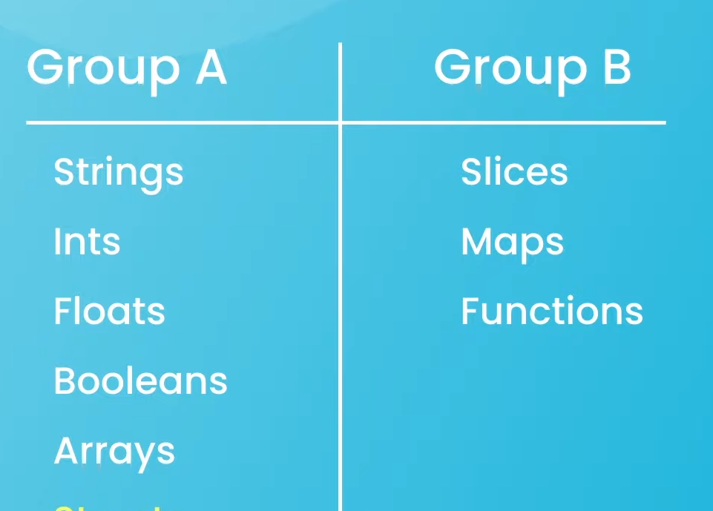
Pass By Value
Go is a pass by value Lanaguage
This basically means that when we pass variables around as arguments in functions go makes a copy of those values, for the functions use
Go make “copies” of values when passed int functions

Slide 16
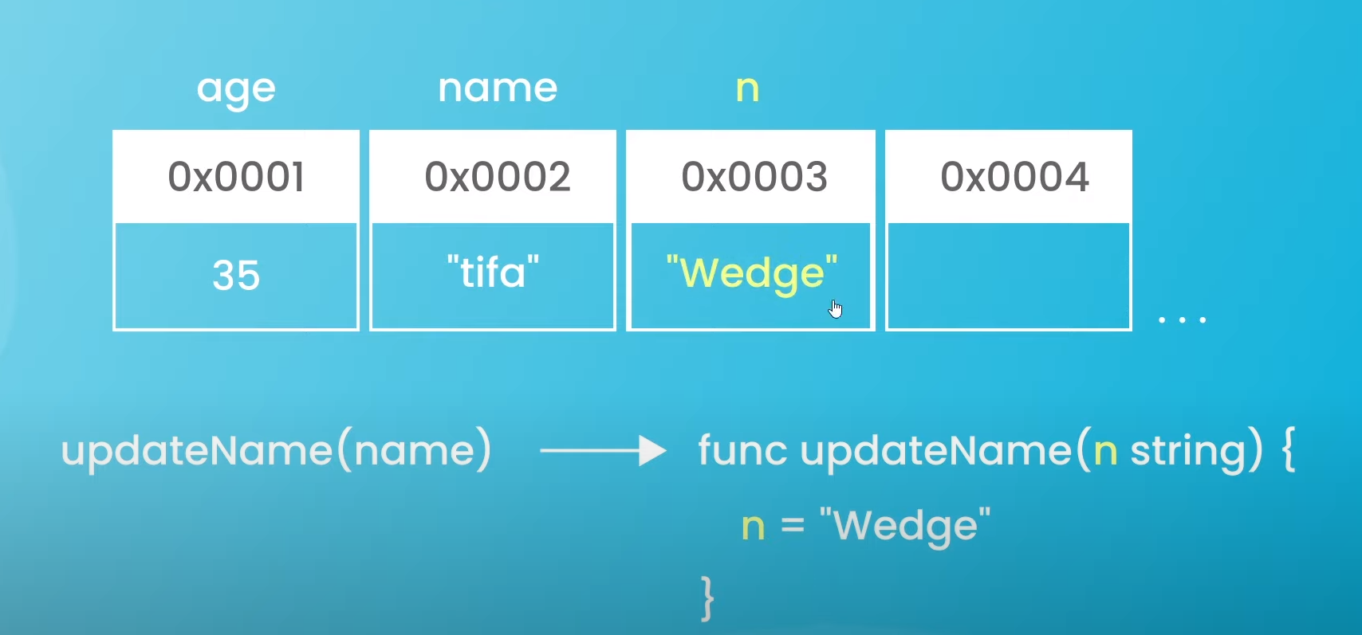

Slide 17
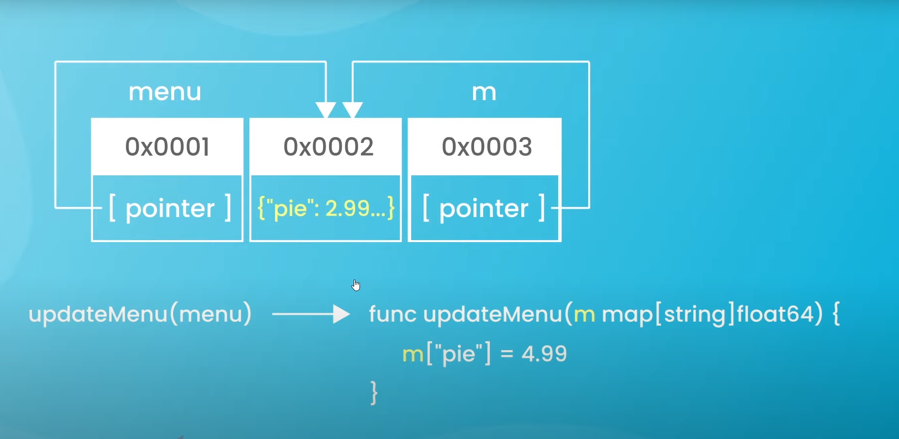

Slide 18
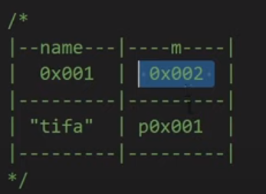
Pointers
In Go lang, pointers are special variables that are used to store the memory address of other variables and point to their memory address. Pointers also provide ways to access the value of the variable stored in that address.
The * operator: While declaring a pointer, the pointer name is followed by the type of the variable the pointer points to, prefixed with the * sign as shown below. This is also known as dereferencing the pointer variable.

Slide 19
What is the need for the pointers?
Variables are the names given to a memory location where the actual data is stored. To access the stored data we need the address of that particular memory location. To remember all the memory addresses(Hexadecimal Format) manually is an overhead that’s why we use variables to store data and variables can be accessed just by using their name.
To remember all the memory addresses(Hexadecimal Format) manually is an overhead that’s why we use variables to store data and variables can be accessed just by using their name.
Nil Pointers
var intPtr *int
fmt.Println(intPtr) //output: <nil>

Slide 20
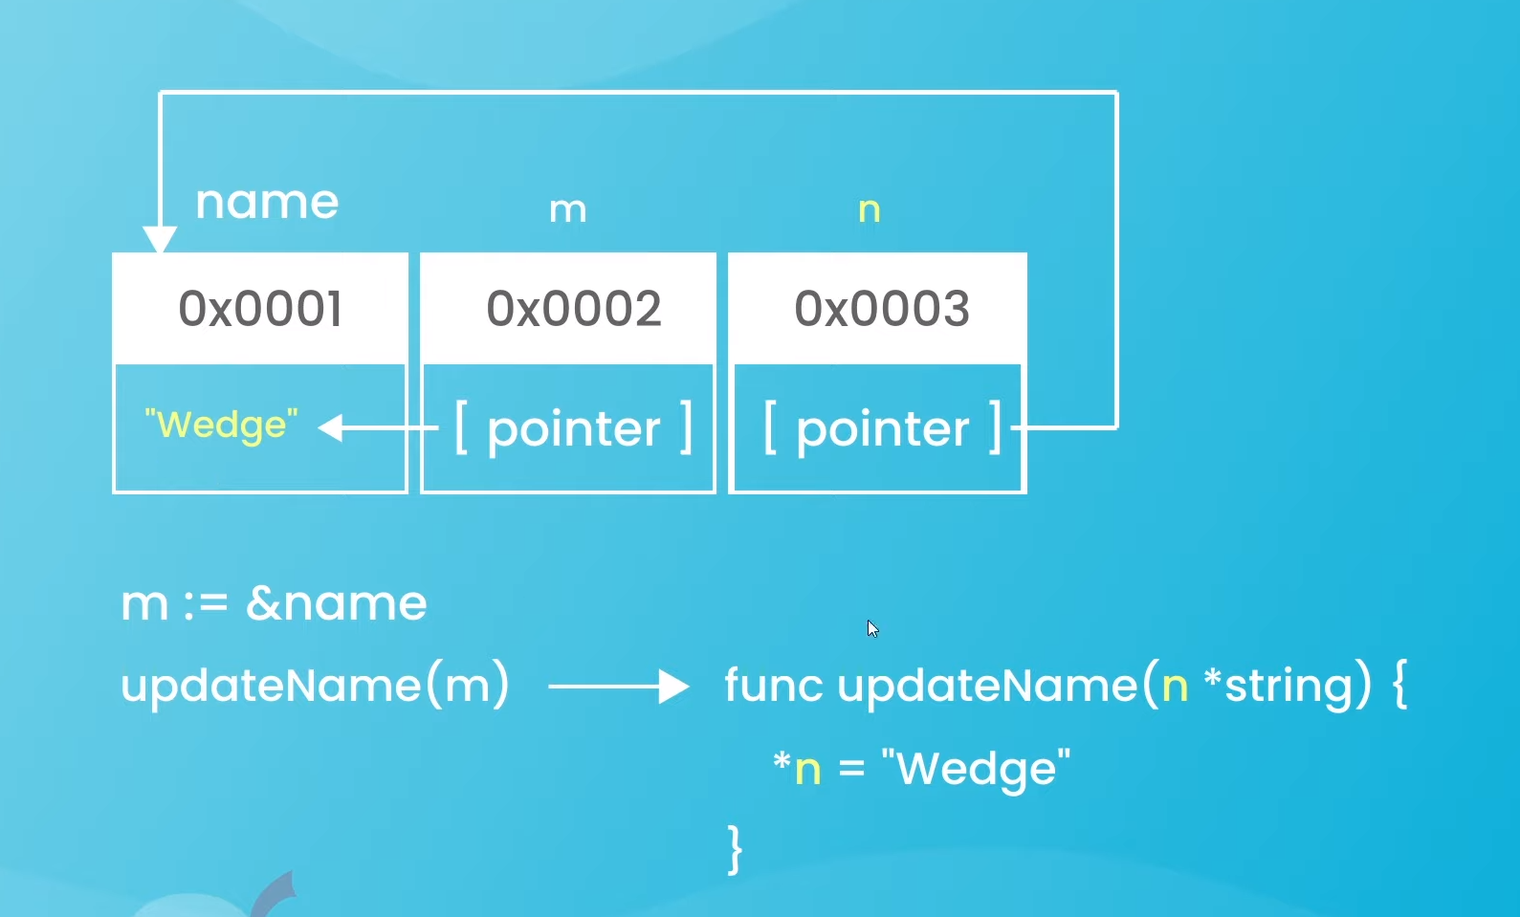

Slide 21
Go Pointer to Pointer (Double Pointer)
Pointers in Go programming language or Golang is a variable which is used to store the memory address of another variable.
A pointer is a special variable so it can point to a variable of any type even to a pointer.
Basically, this looks like a chain of pointers.
When we define a pointer to pointer then the first pointer is used to store the address of the second pointer.
This concept is sometimes termed as Double Pointers.
The difference is we must place an additional ‘*’ before the name of pointer name.
This is generally done when we are declaring the pointer variable using the var keyword along with the type.

Slide 22
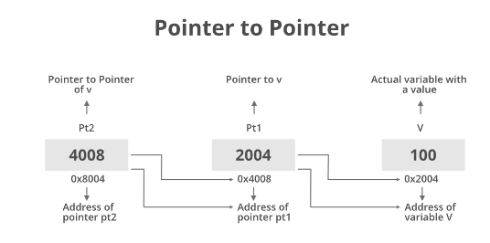

Slide 23
Structs & Custom Types
Now we are going to start building the build program.
Using cutom data type for our bills and bill might include several diff properties for example name a which could be a string, The items of food and their prices which could be a map & tip as well which could be a float64
So, This would kind of be like a custom object structure with these three properties.
Example:-

Slide 24
Receiver Functions
Go is very similar to C due to presence of pointers, static typing and many other things. But Go is a modern language and so it has many new features baked in it.
One notable feature is receiver functions.
Let's have an example:-

Slide 25
Receiver Functions with Pointers
Pointer receiver passes the address of a type to the function. The function stack has a reference to the original object. So any modifications on the passed object will modify the original object.
Let’s understand this with the example-

Slide 26

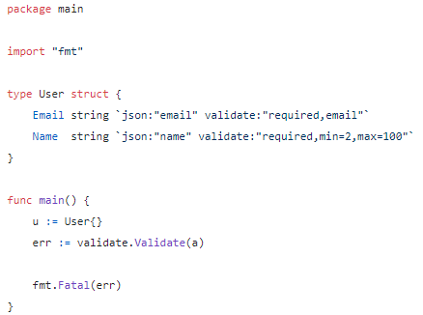
Input validation in GoLang
As long as data is mostly used, manipulated or transferred through structs in Go it all boils down to validating a pre-defined struct which matches the expected input data format.
Whether the input consumer is an HTTP API or Lambda/Cloud function the very first thing is to unmarshal the input stream into a struct

Slide 27
Thank You

